Slide 1

Customer Behavior Analysis for Retail Success
Unlocking insights to drive sales, satisfaction, and loyalty

Slide 2
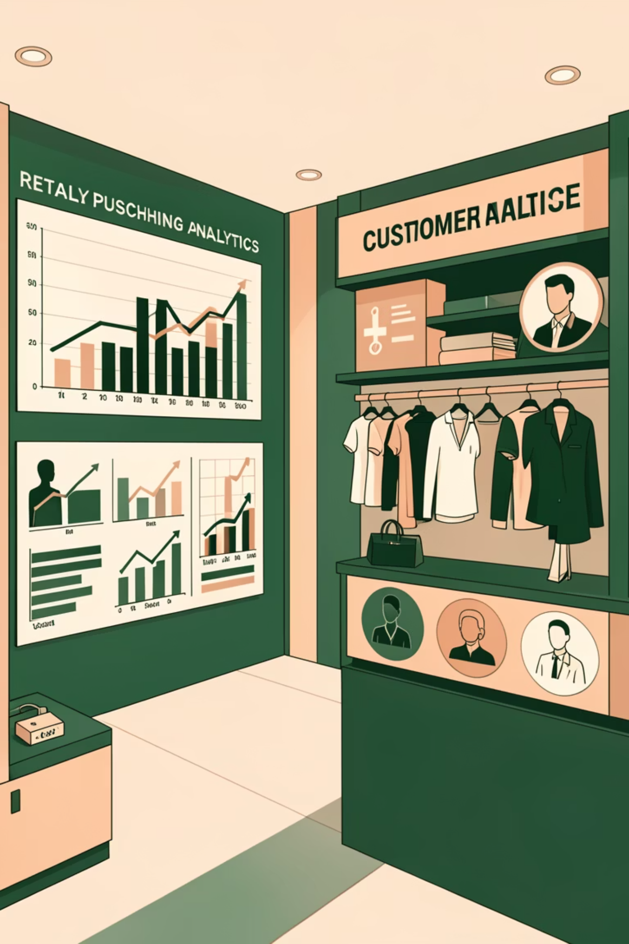
The Challenge: Understanding Evolving Customer Behavior
Our retail company seeks to better understand customer shopping behavior to improve sales, satisfaction, and long-term loyalty.
Changing Patterns
Noticing shifts in purchasing across demographics, product categories, and sales channels (online vs. offline).
Key Drivers
Uncovering factors like discounts, reviews, seasons, and payment preferences that drive consumer decisions and repeat purchases.
Leveraging Data
How can we use shopping data to identify trends, enhance engagement, and optimize strategies?

Slide 3

Our Data: A Comprehensive Look at Customer Purchases
The dataset provides a rich view into consumer actions across various locations, product types, and seasons.
Customer Demographics
Age, Gender, Customer ID
Purchase Details
Item, Category, Amount, Size, Color
Geographical Context
Location
Seasonal Trends
Season
Feedback & Engagement
Rating, Reviews
Logistics & Offers
Shipping Type, Discount Used, Promo Code Used
Transaction Details
Payment Method, Order Frequency, Total Orders

Slide 4
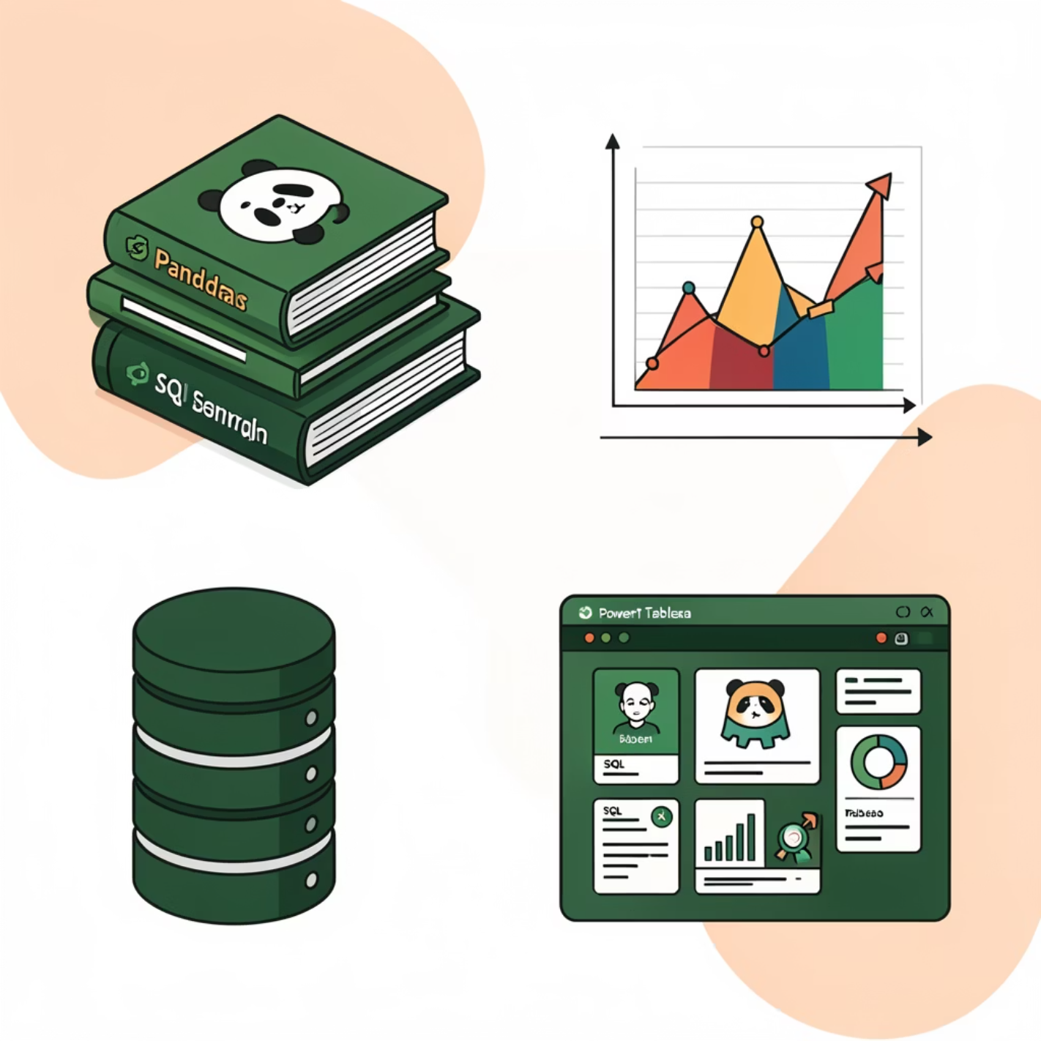
Our Analytical Toolkit & Workflow
A robust set of tools and a systematic approach ensured thorough analysis and insightful findings.
Tools Utilized
Python (Pandas): Data assessing & cleaning
Matplotlib & Seaborn: Exploratory Data Analysis visualizations
SQL: Data analysis and insights extraction
Power BI & Tableau: Final interactive dashboards and story integration

Slide 5
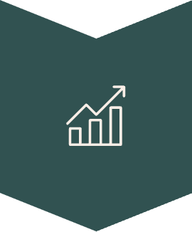


Our Analytical Toolkit & Workflow
Data Assessing
Data Cleaning
(Python Pandas)
Exploratory Data Analysis
(Matplotlib, Seaborn, SQL)
Insights Formulation
Dashboard Design
(Power BI, Tableau)

Slide 6
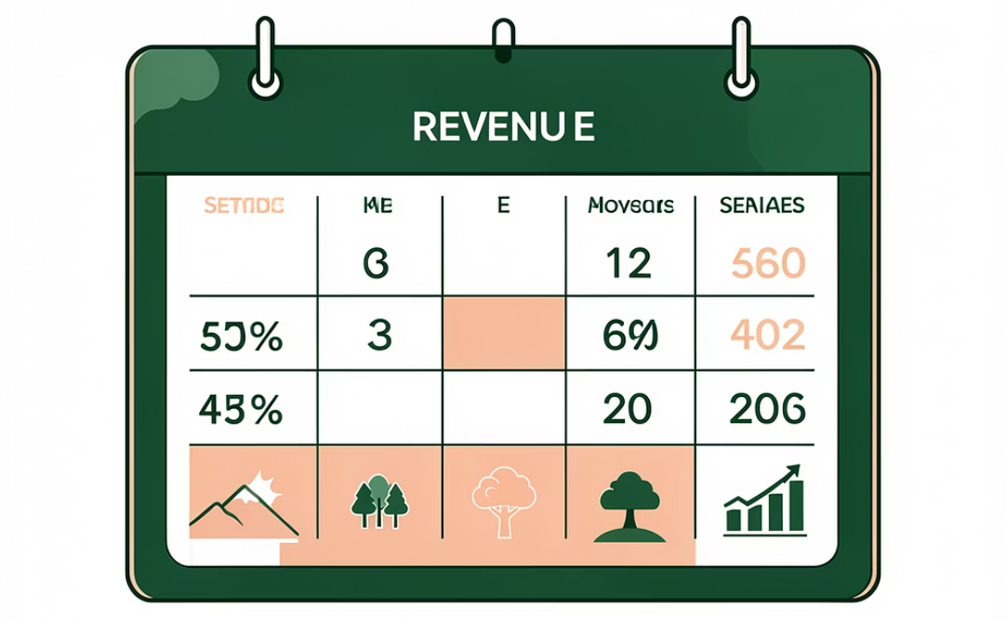
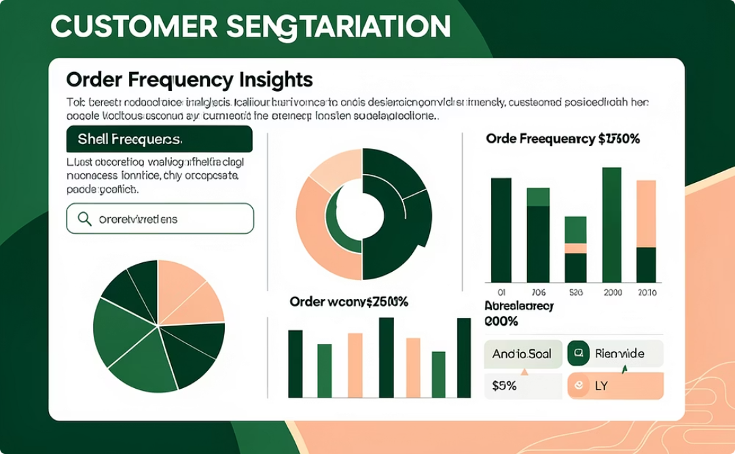
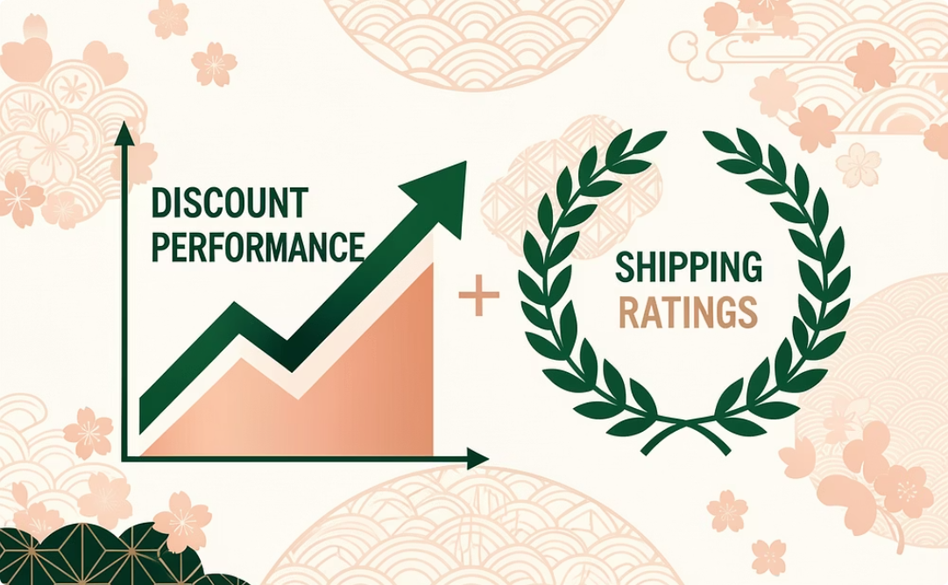
Dashboard Focus: Uncovering Key Performance Areas
Three targeted dashboards provide a deep dive into revenue, customer engagement, and operational performance.
Revenue Rhythms: Season & Category Performance
Customer Footprint & Engagement Insights
Delivering Delight: Satisfaction & Operational Performance
Visualizes sales and revenue variation by season and product categories, identifying peak periods and top-performing segments.
Highlights customer segments, order frequency patterns, and regional distribution to understand our customer base.
Analyzes how shipping methods and discounts impact customer ratings and overall experience.

Slide 7
Key Insights: What the Data Revealed
Our analysis uncovered several significant patterns in customer behavior and operational performance.
Seasonal Peaks
Most orders were placed during the Spring season, while the Fall season accounted for the most costly orders.
Shipping Anomaly
Standard shipping surprisingly received higher ratings than faster methods like Next Day Air and Store Pickup.
Regional Disparities
Minnesota and Delaware had fewer orders compared to other states, indicating potential growth areas.
Underperforming Colors
Products in Maroon, Violet, and Gray had comparatively lower sales.
Top Category & Loyalty
The Clothing category was the biggest revenue driver, with loyal customers accounting for roughly 80% of revenue.
High-Frequency Buyers
Weekly and Fortnightly buyers showed higher spending behavior, highlighting the value of frequent purchases.

Slide 8

Strategic Recommendations for Growth
Leveraging these insights, we can implement targeted strategies to optimize sales and customer satisfaction.
1
2
3
Seasonal Marketing Boost
Investigate Shipping Performance
Targeted Color Promotions
Focus marketing campaigns on Spring and Fall to capitalize on peak demand and high-value orders.
Run color-based promotions for low-performing items in Maroon, Violet, and Gray to clear inventory and attract new buyers.
Deep dive into why Standard shipping outperforms premium options to address potential pricing or reliability issues with faster methods.

Slide 9
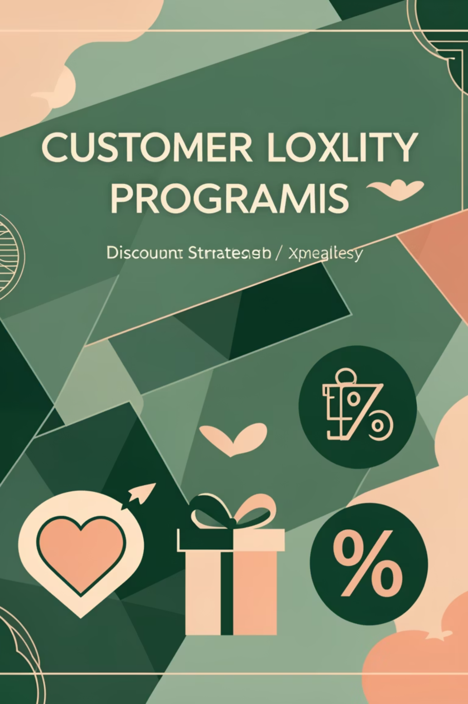
Strategic Recommendations for Growth (Cont.)
1
2
Enhance Loyalty Programs
Strategic Discounting
Encourage subscription and loyalty programs specifically for high-frequency buyers to maximize their lifetime value.
Focus discount offers strategically to boost engagement without negatively impacting customer ratings or brand perception.
3
Regional Market Expansion
Develop tailored campaigns for underserved regions like Minnesota and Delaware to tap into new customer bases.

Slide 10

Thank You
Your feedback is invaluable. Let's discuss how to turn these insights into action.
Sagar Kumar
Data Analyst Enthusiast
For further insights and collaborations, feel free to connect
GitHub - shttps://github.com/sagar-data-ai
Linkedin - www.linkedin.com/in/sagar-datascience

